Slide 1
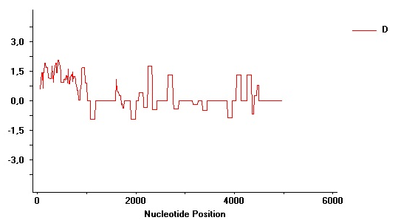

5 UTR
DHDPS Medtr7g075090
3 UTR
Tajima’s D
Nucleotide Position

